Slide 1
Analysis and Analytics of Coronavirus Tweets and Political Tweet Traits
Team 1A
Mehmet Acikgoz
Jonathan Wolfe

Slide 2
Motivation
Twitter makes public Tweets and replies available to developers,and allow developers to post Tweets via API.
These tweets can easily be used by people to identify, understand and counter misinformation around public health initiatives.
We collected tweets on the topic “coronavirus” and saved them to files to perform further analysis with Map-Reduce, Hive and Spark Framework.

Slide 3
Introduction
The advances in science and technology have made the modern lifestyle more interactive with people through social media such as Twitter.
Besides this personal use of Twitter, it also provides valuable information about the global threats such as COVID19 pandemic.
We believe that Twitter messages provide instant pictures of threat that will shed light to unseen part of the pandemic.

Slide 4
Background
Twitter has been analyzed countless times involving numerous types of statistical interpretations for different reasons
We decided to look at the features of tweets with #Coronavirus in English and implement various queries on this dataset.
In addition, we will extend past works analyzing political tweets and learn how features of tweets relate to its likelihood of being political.

Slide 5
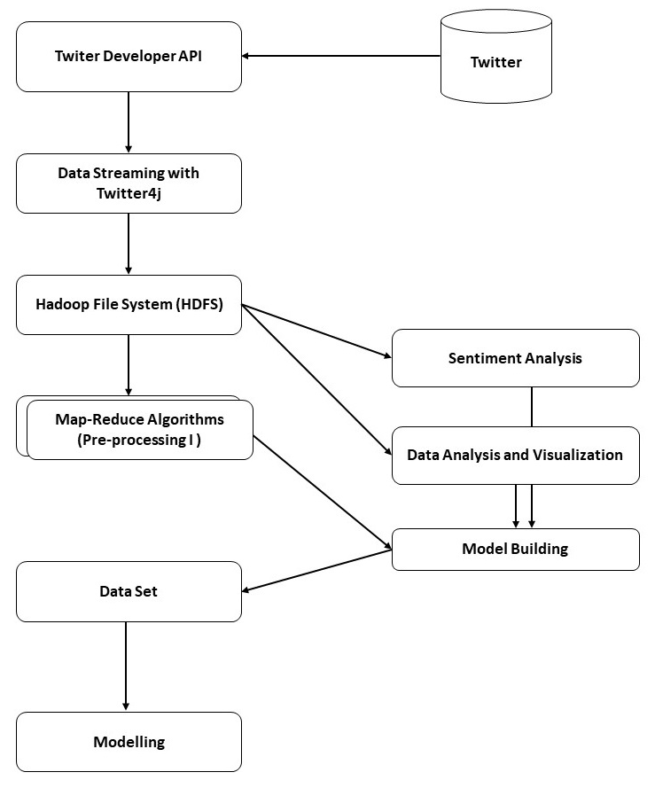
Model
Collect tweets via Twitter4j
Saving to HDFS
Multiple Analysis with Map-Reduce Algorithms
Sentiment Analysis
Data Analysis and Visualization
Model Building
Modelling & Using MLIB

Slide 6
Dataset
The data set used in this project is collected on between 2.30-6.51 UTC on March 14.
The data set contains 199,924 tweets.
Data is in json format per line.
The following fields are taken into account for modelling and ML.
id, created.at, full.text, user.created.at, retweet.count, user.follower.count, user.friend.count, user.listed.count

Slide 7
Preliminary Data Analysis with Map-Reduce
To find out the people tweeting more than others.
Algorithm:
Process all tweets and parse out tokens with ‘user.id’ str
Count all the ‘user.id’ str's.
Find out top n ‘user.id’ str's by sorting them
In order to perform this analysis we created 2 separate Map-Reduce jobs;
first one covering from step-1 and step-2
the second one covering step-3 (for sorting)

Slide 8
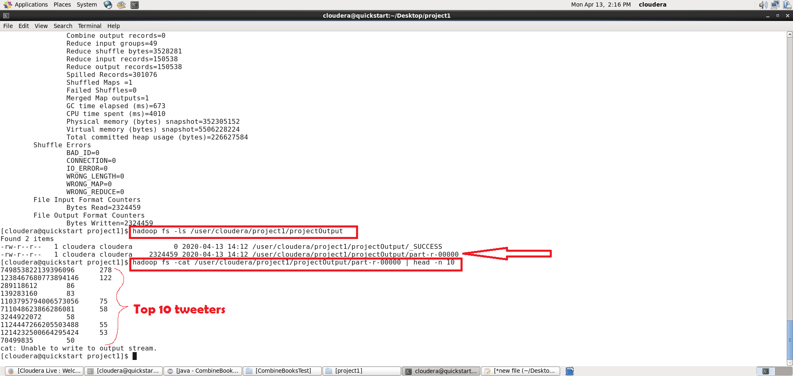
Preliminary Data Analysis with Map-Reduce

Slide 9
Detailed Data Analysis with Spark
Before we create the model, it would best to understand the dataset we have.
We created 8 queries in SparkSQL and performed Sentiment Analysis in order to better understand the data that will eventually help us in building the model.
We used some other cutting edges tools such as pandas, matplotlib in addition to Apache Spark.

Slide 10
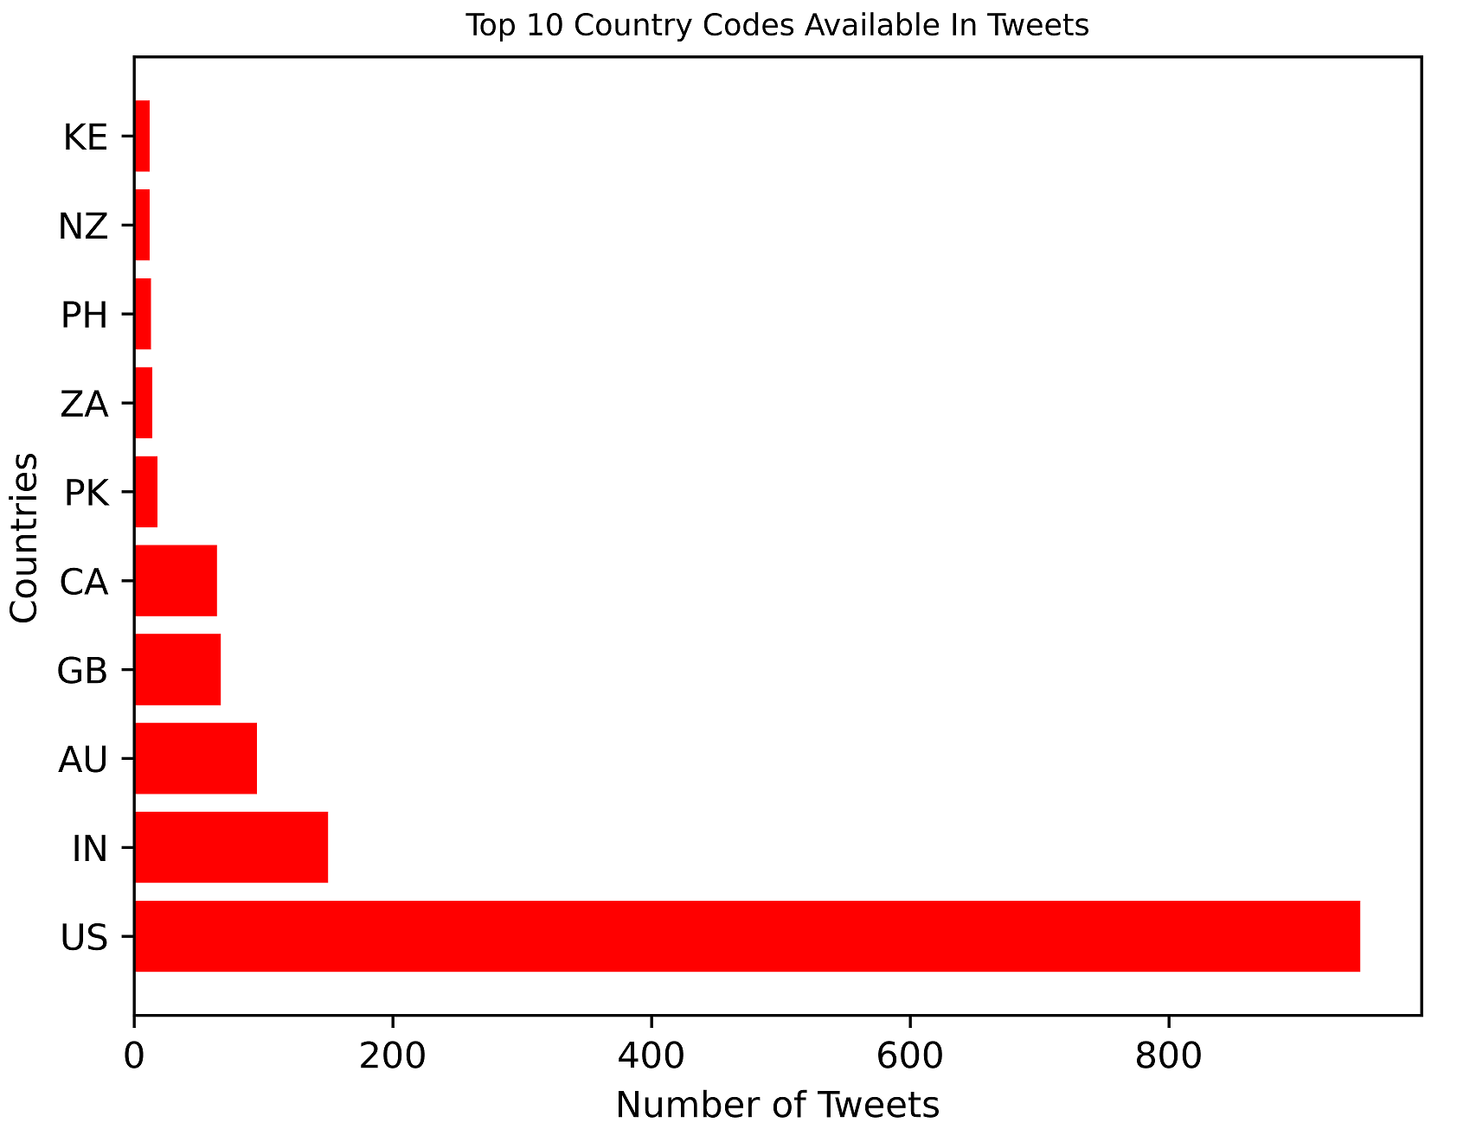

Slide 11
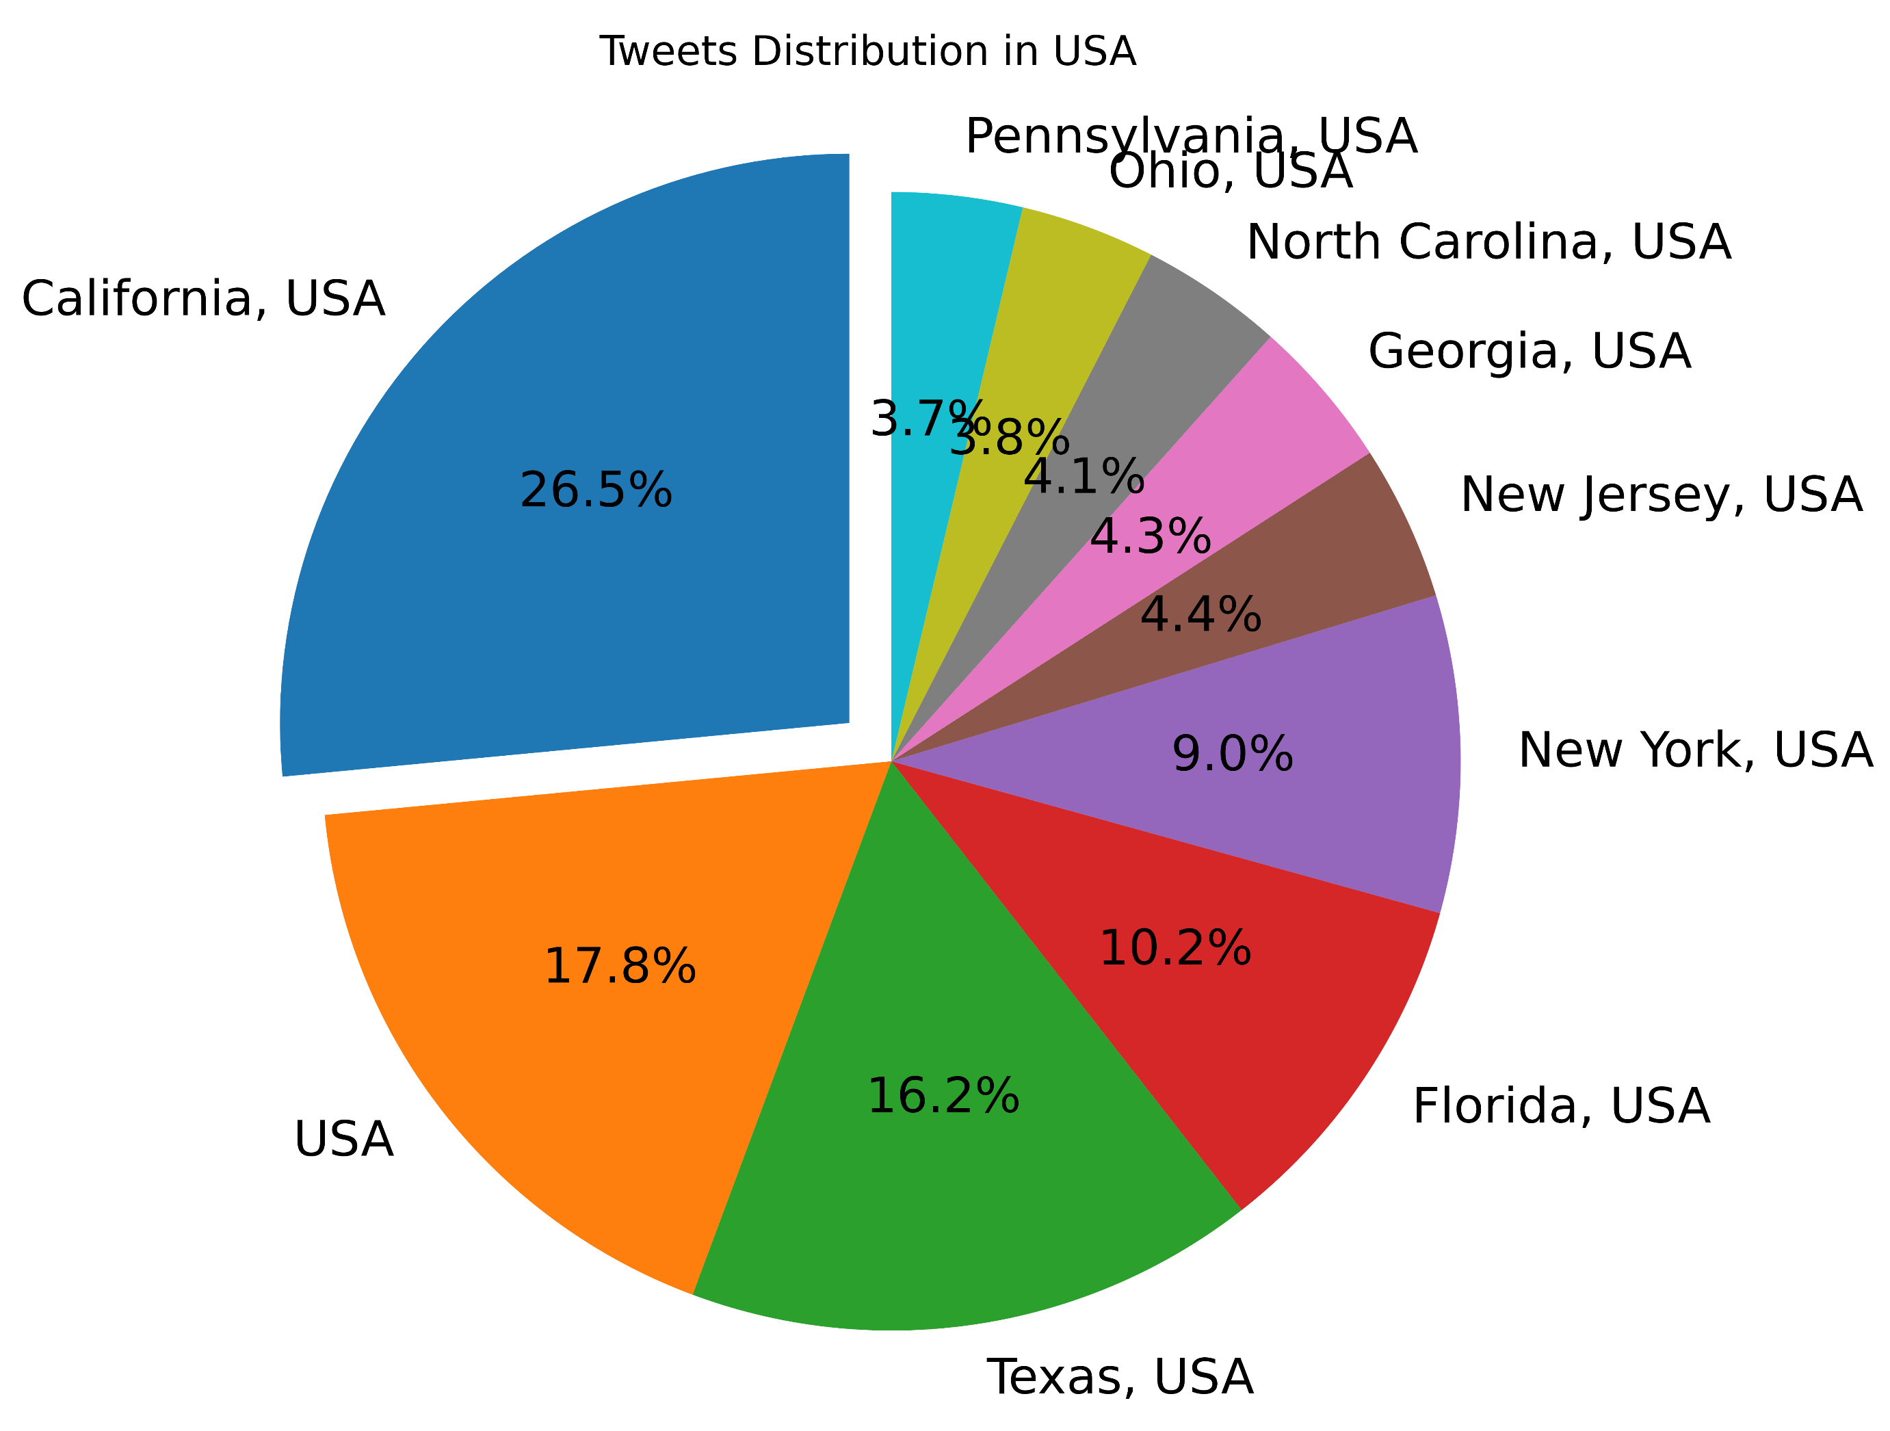

Slide 12
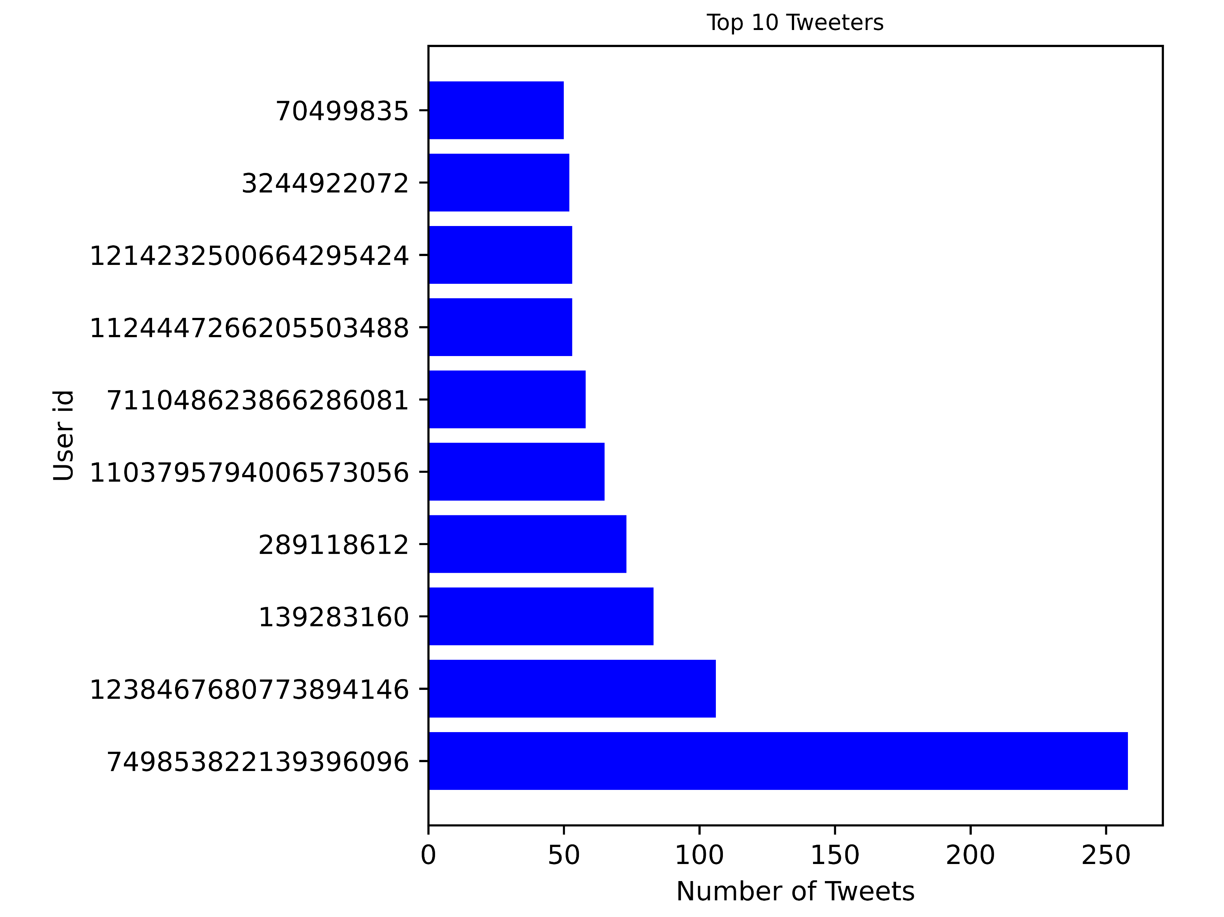

Slide 13
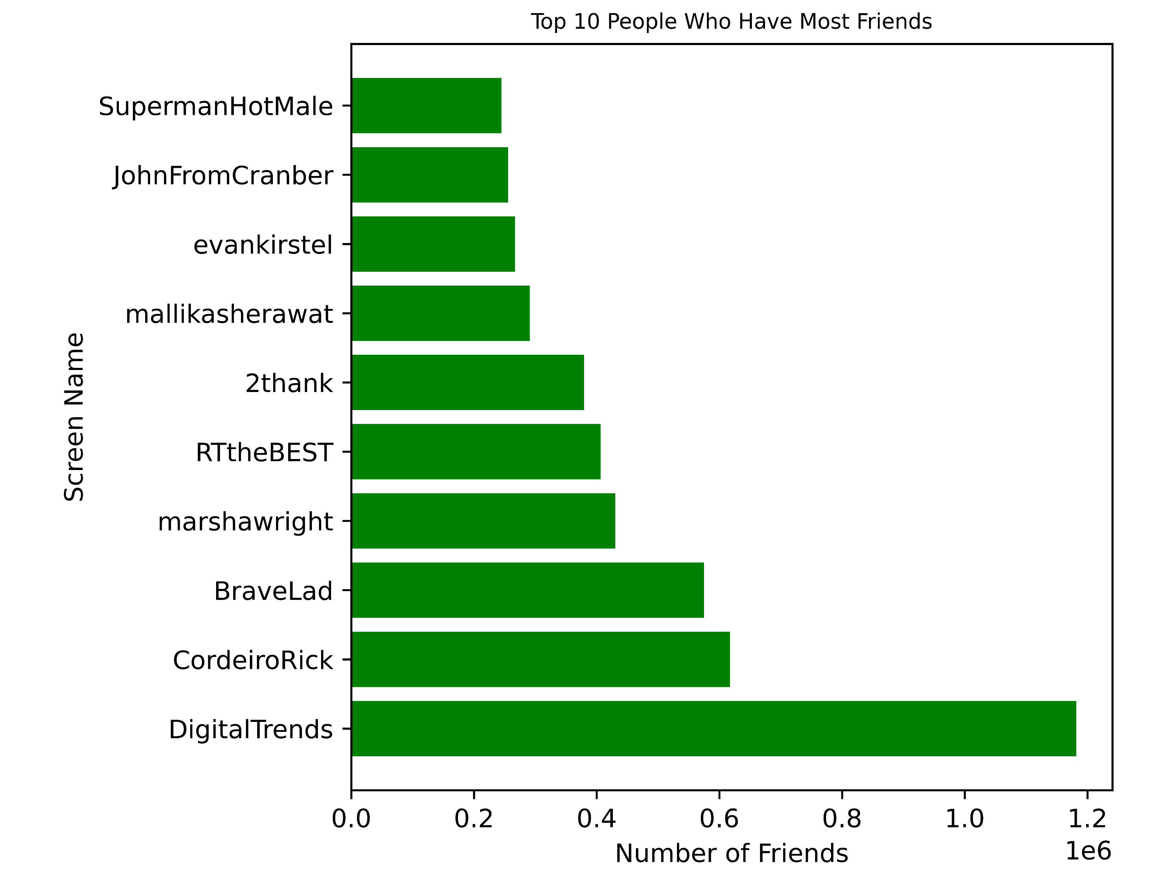

Slide 14
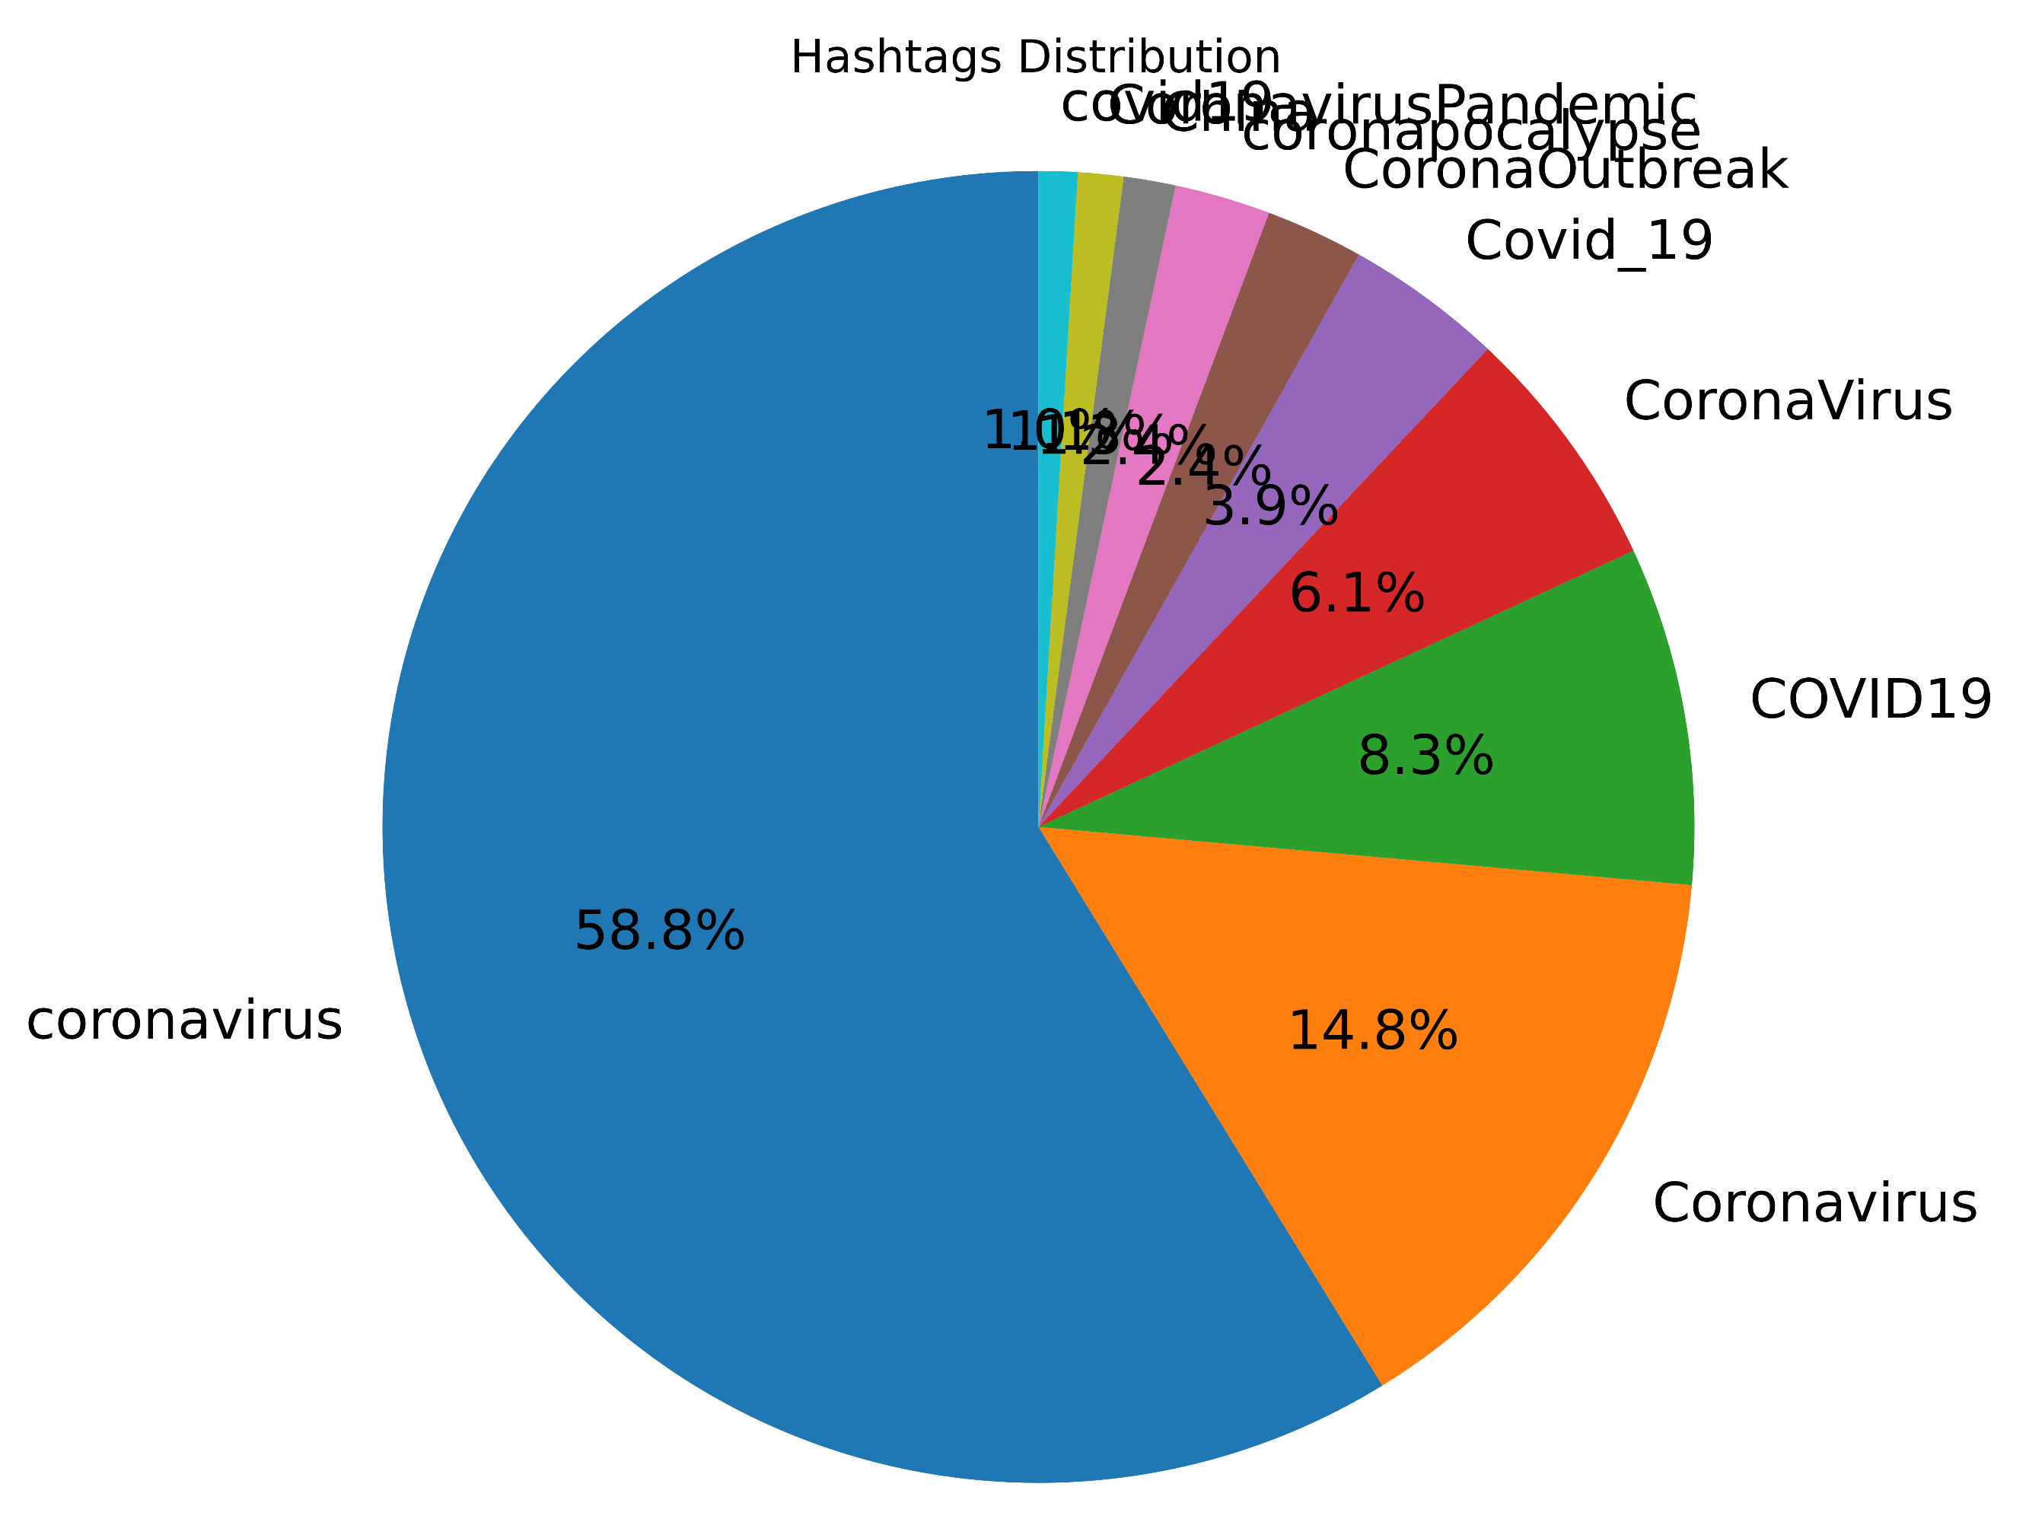

Slide 15
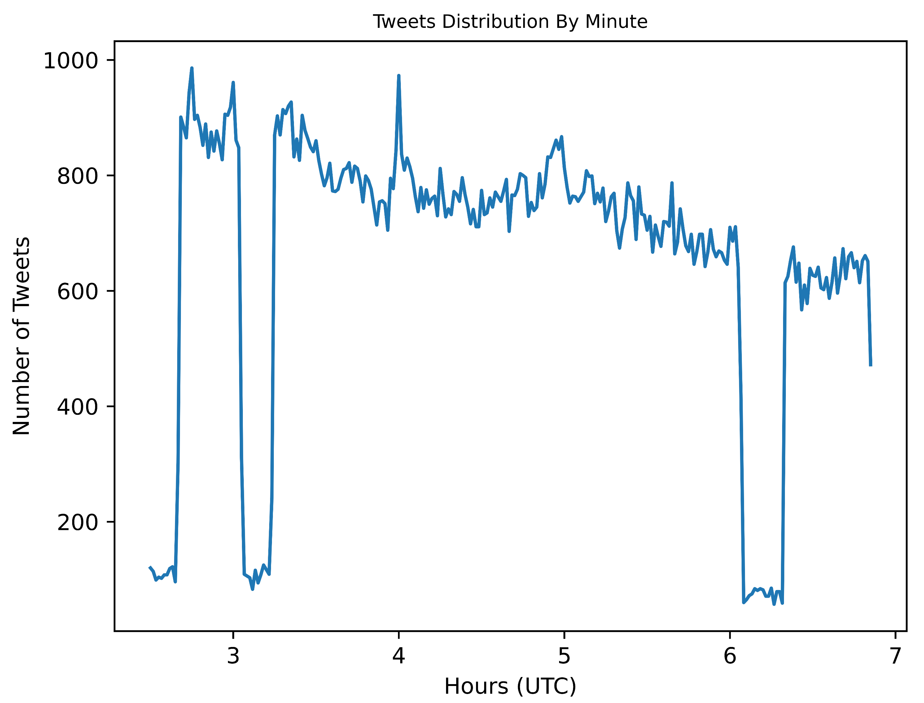

Slide 16
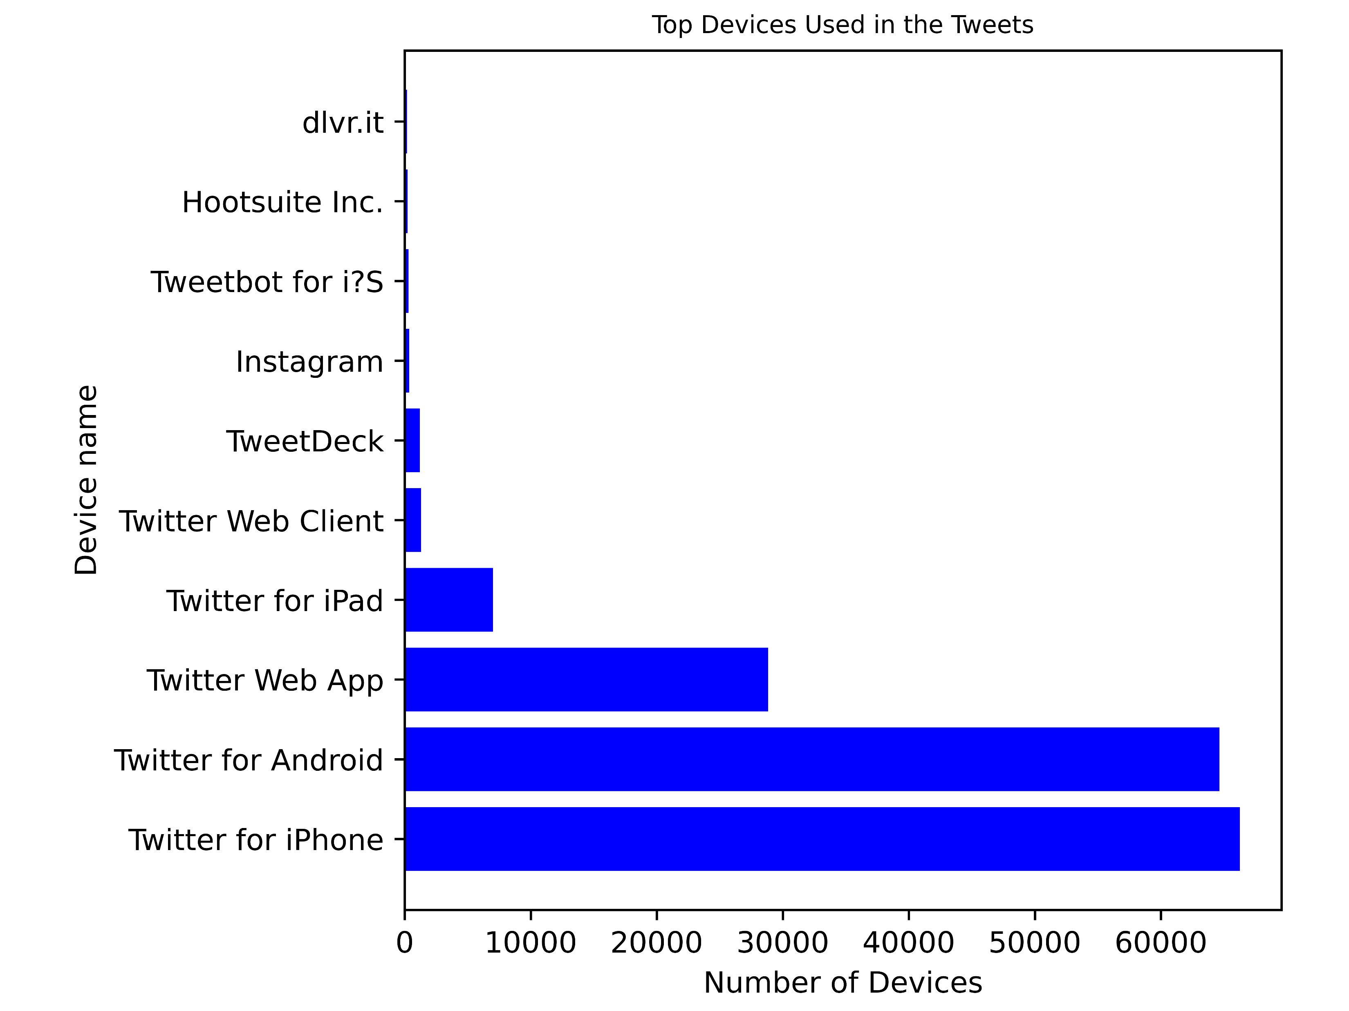

Slide 17
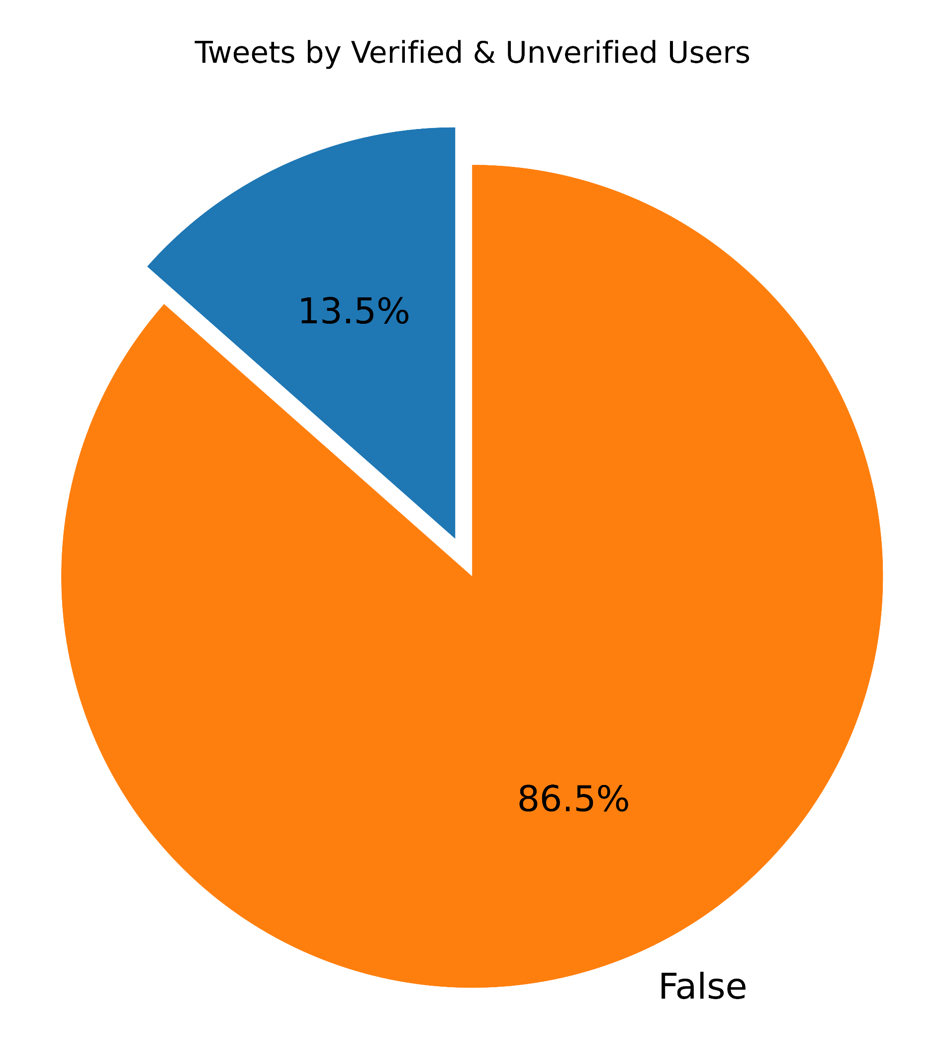

Slide 18
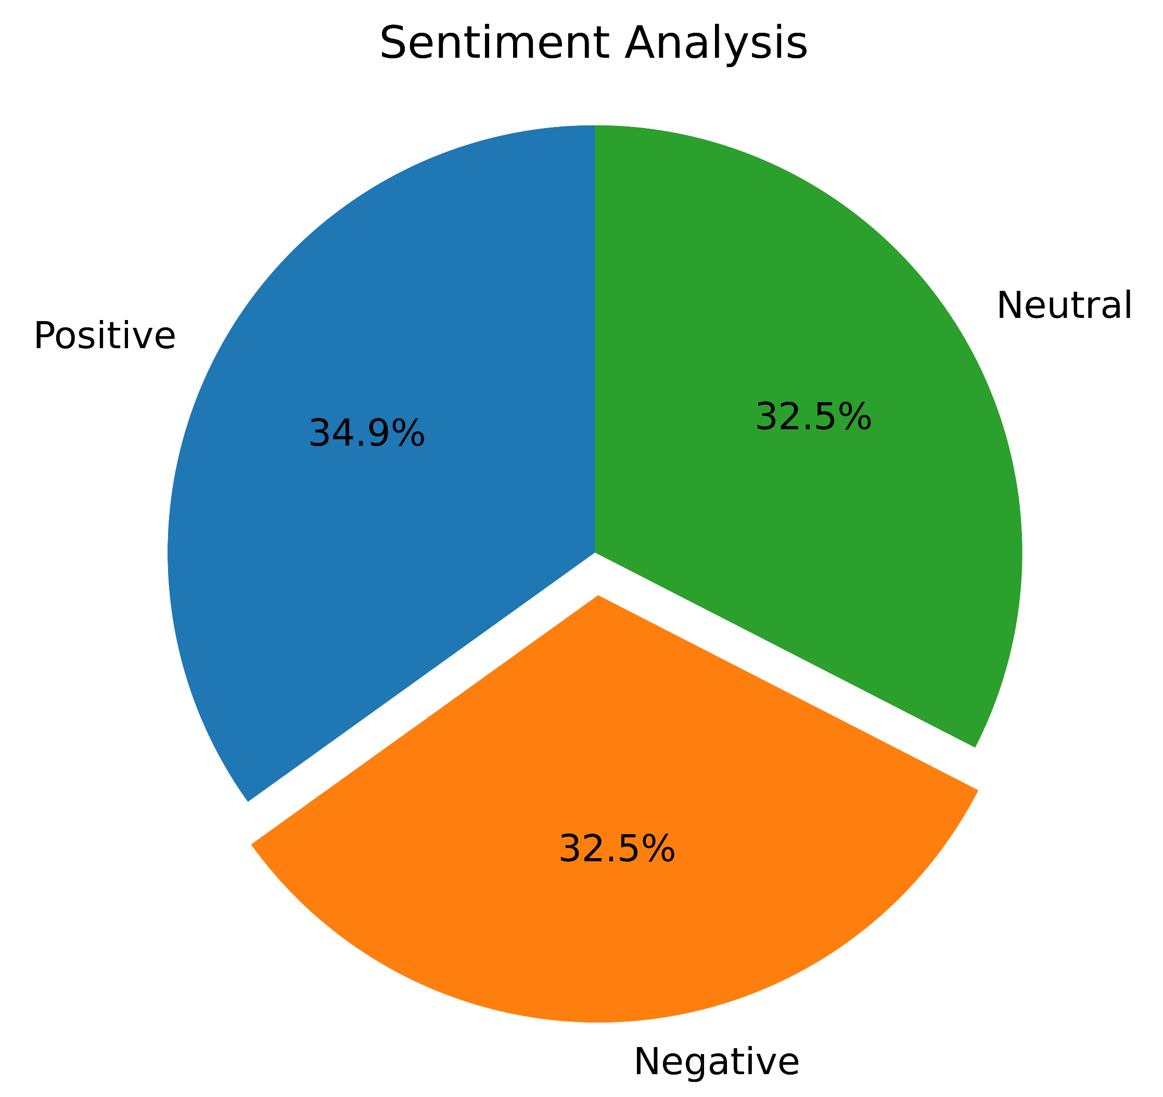

Slide 19
Data Pre-processing (Political Tweets)
The first step in generating a data set to use for the development of a model was to develop a list of political terms to determine if a tweet is political.
To develop this list, we use Map-Reduce to make a word count and order it by the count so that the most frequent words appear on top.
The first part of this program was a traditional Map-Reduce applied to each tweet's full text converted to lower-case and with special characters removed
A column identifying if the tweet is political with a 1 and not political with a 0 was generated from a list of key words after the text had been converted to lower-case and special characters were removed using a user-defined function.

Slide 20
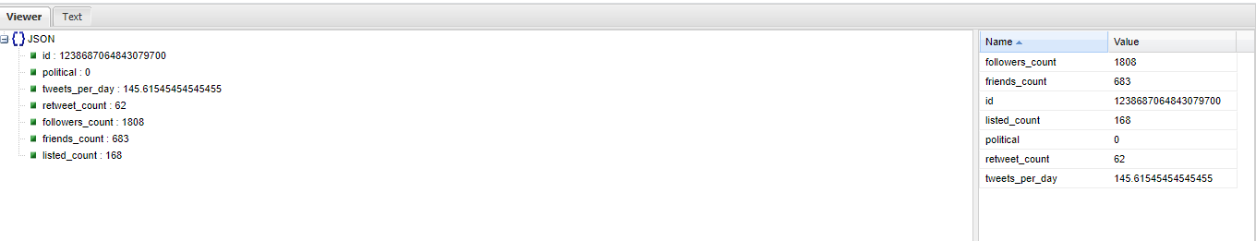
Data Pre-processing (Tweets per Day)
The data was processed to remove null values for select columns and dates were converted to timestamps to make the dates usable by Spark
The time the tweet was created and the time the user account was created were compared to get the time the account has been active and divided this by the amount of status updates for the account to get the average tweets per day, then the selected data was output to a json file.

Slide 21
Modeling
Independent: tweets per day {double}, retweet count {int}, followers count {int}, friends count {int}, listed count {int}
Dependent: political {boolean}
Models:
Logistic Regression
Naïve Bayes
Decision Tree
Random Forest
Gradient Boosted Tree
70% Training set (173,202), 30% Testing (51,941)

Slide 22
Model Evaluation
Model | True Positive | False Positive | False Negative | True Negative | Total
Logistic Regression | 103 | 158 | 13309 | 38371 | 51941
Naïve Bayes | 8753 | 21470 | 4659 | 17059 | 51941
Decision Tree | 290 | 46 | 13122 | 38483 | 51941
Random Forest | 483 | 127 | 12929 | 38402 | 51941
Gradient Boosted Tree | 2414 | 1480 | 10998 | 37049 | 51941

Slide 23
Model Evaluation
Model | Accuracy | Precision | Sensitivity | Specificity | F1 Score | AUC
Logistic Regression | 0.741 | 0.395 | 0.008 | 0.996 | 0.015 | 0.502
Naïve Bayes | 0.497 | 0.290 | 0.653 | 0.443 | 0.401 | 0.548
Decision Tree | 0.746 | 0.863 | 0.022 | 0.999 | 0.042 | 0.510
Random Forest | 0.749 | 0.792 | 0.036 | 0.997 | 0.069 | 0.516
Gradient Boosted Tree | 0.760 | 0.620 | 0.180 | 0.961 | 0.279 | 0.571

Slide 24
Conclusion
There is a large volume of tweets concerning coronavirus in English
Most of the users use the mobile platform, are from California and split between positive, neutral and negative connotations.
Gradient Boosted Tree performed better than the other models
Tweets per day, retweet count, followers count, friends count and groups count are not good predictors for classifying political tweets

Slide 25
Context Based Sentiment Analysis
Team 1B
Attaluri Lalith Chandra
Karumanchi Pranitha Saroj

Slide 26
Abstract
The main idea of our project is to use Spark Streaming to do the ETL process and to implement the machine learning concepts on that data in real time.Our device source is titter data ande’d be using Streaming Content, Which is real-time data processing and using streaming API we’d do the transformations on the RDD’S streaming set and load the data into the hive framework which is similar to the basic ETL method. We will also be executing the EDA on twitter data while capturing the databackground. Our project would also highlight the sentiment analysis system where the tweets are populated with real-time sentiments. It also describes the keyword reasons for categorizing a tweet into positive or negative sentiment.

Slide 27
Architecture Flow
Data collection (Twitter API)
Streaming
Client/server model
Train-Test (Model)
Sentiment Comparision
Hive
Comparing UDF & PDF

Slide 28
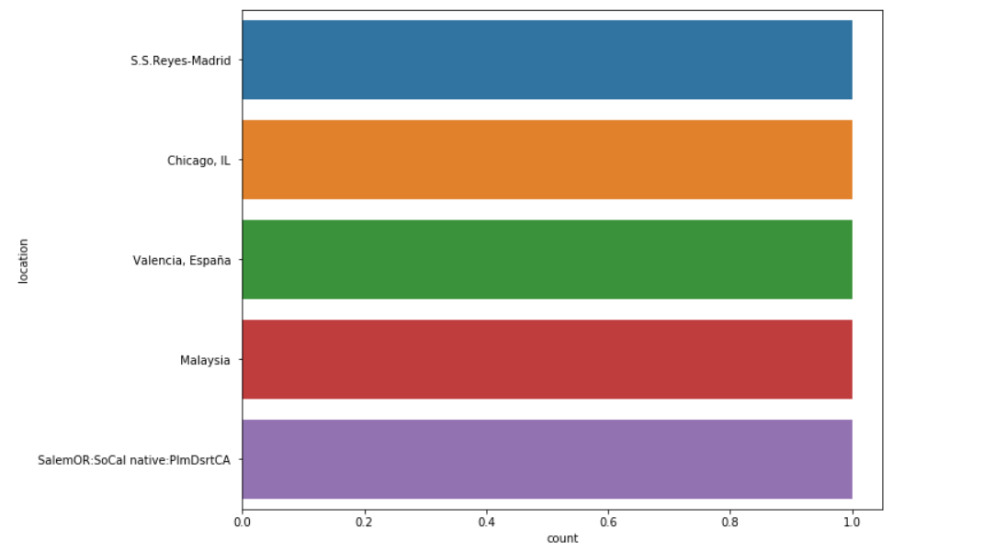
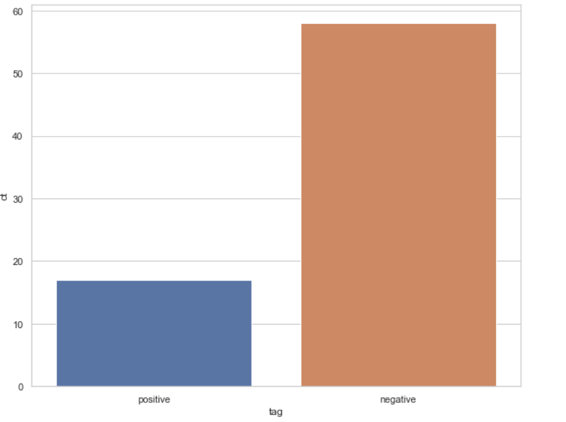
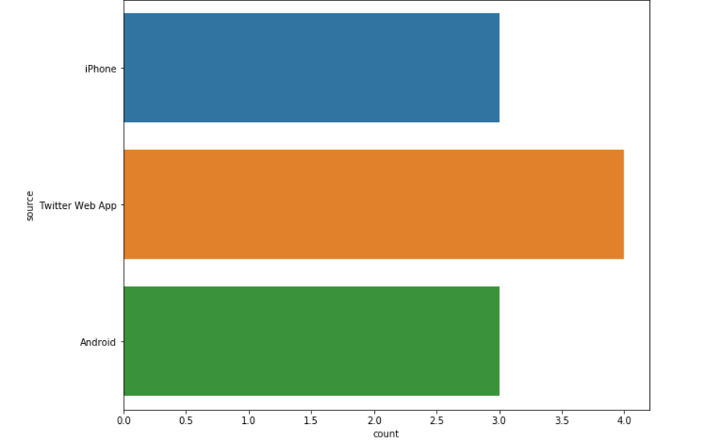
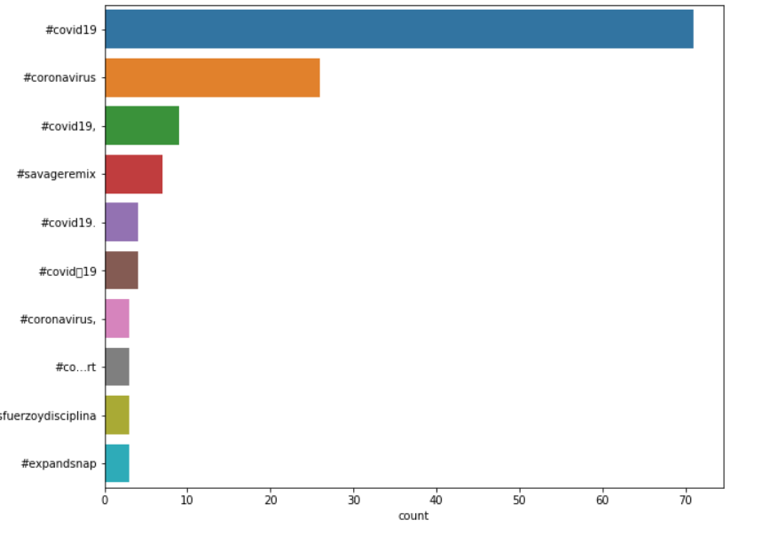
Data Visualization

Slide 29
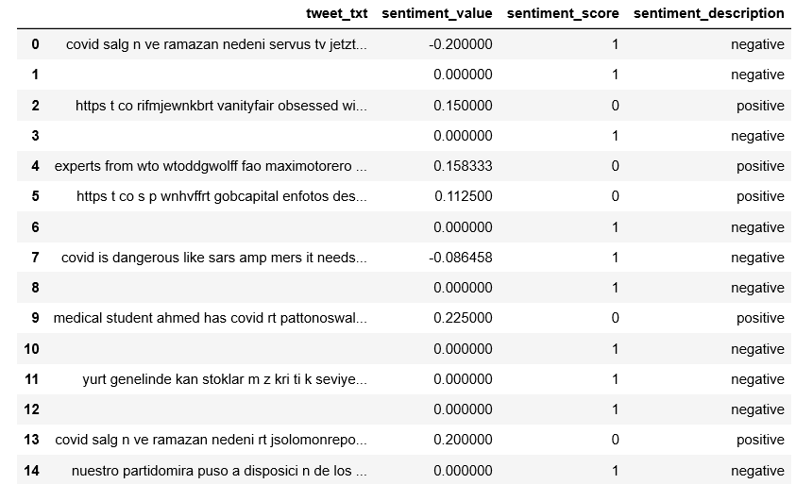
Data Preprocessing

Slide 30
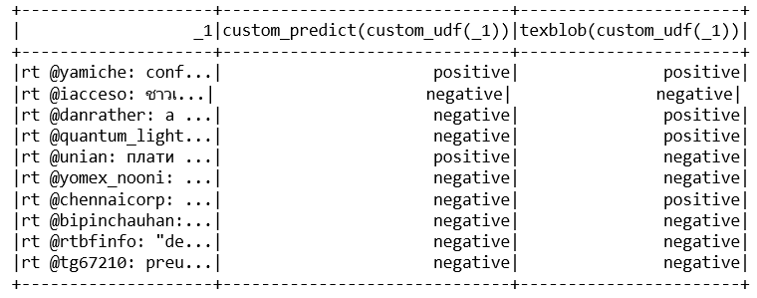
Sentiment Analysis of Real-Time Data

Slide 31
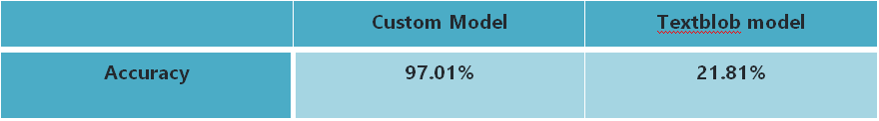
Models-Comparision

Slide 32
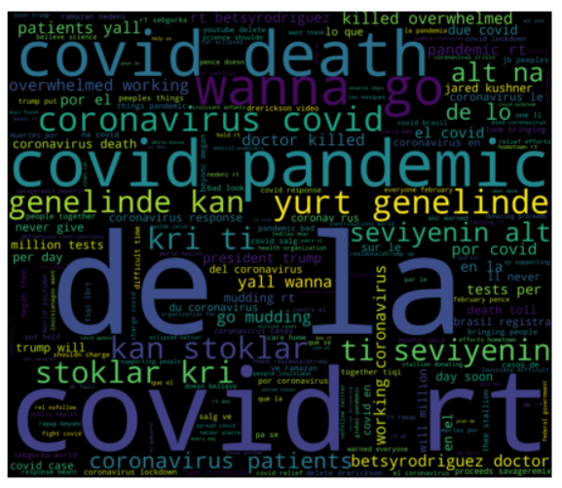
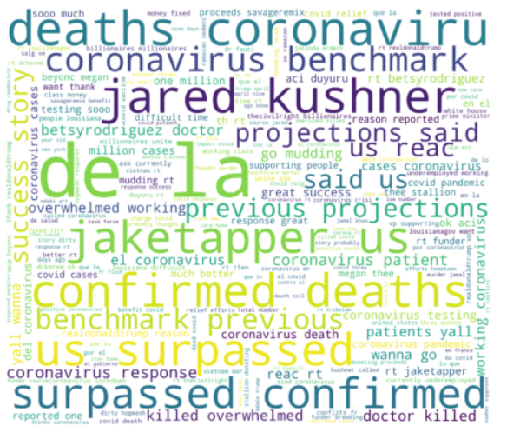
Features of Sentimental Analysis

Slide 33
Conclusion
From our analysis, we conclude that the context-based model has good accuracy than the pre-trained models.
Important features are covid, pandemic, death
Least important features are aa, aarod, aahmad, aalac, accept

